Slide 1




Max 4 Consistency for One Distributor ID

Slide 2
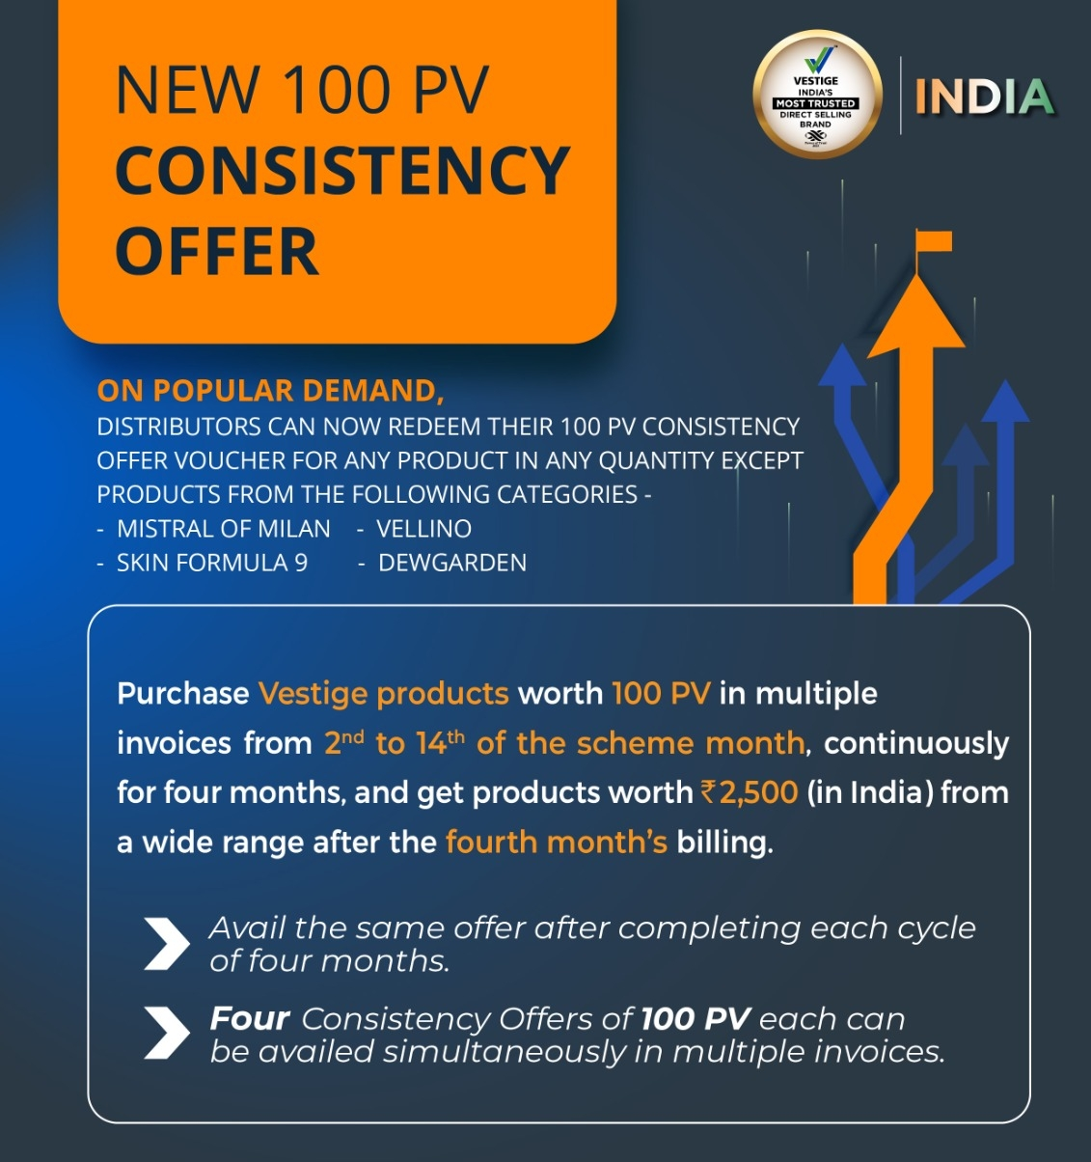

CONSISTENCY OF 100 PV
BETWEEN 2ND TO 14TH EVERY MONTH
Maximum 400 PPV on one ID
BETWEEN 15TH TO 27TH EVERY MONTH
Maximum 20 + PPV Continuous for 4 Month

Slide 3

World class 350 + product range

Slide 4

VESTIGE MD SHRI GAUTAM BALI SAYS
Our Products are really
World’s Best Products in
Different Categories…
But They
Can’t TALK &
They Can’t WALK.

Slide 5
WHAT & HOW TO DO THIS…
From 2nd to 14th Every Month If You do 100 Personal PV then You can do Maximum 100 PV between
15th to 27th (But Minimum 20 PV required Every Month) for Consistency Voucher @ Rs.4/- per PV.
You can do this in Multiple of 100 Personal PV.
NO | 2nd To 14th | 15th To 27th | MAX TOTAL
01 | 100 | 20 to 100 | 200 PPV
02 | 200 | 20 to 200 | 400 PPV
03 | 300 | 20 to 300 | 600 PPV
04 | 400 | 20 to 400 | 800 PPV
Detail Calculation will be
Explained ahead for
Monthly Income

Slide 6
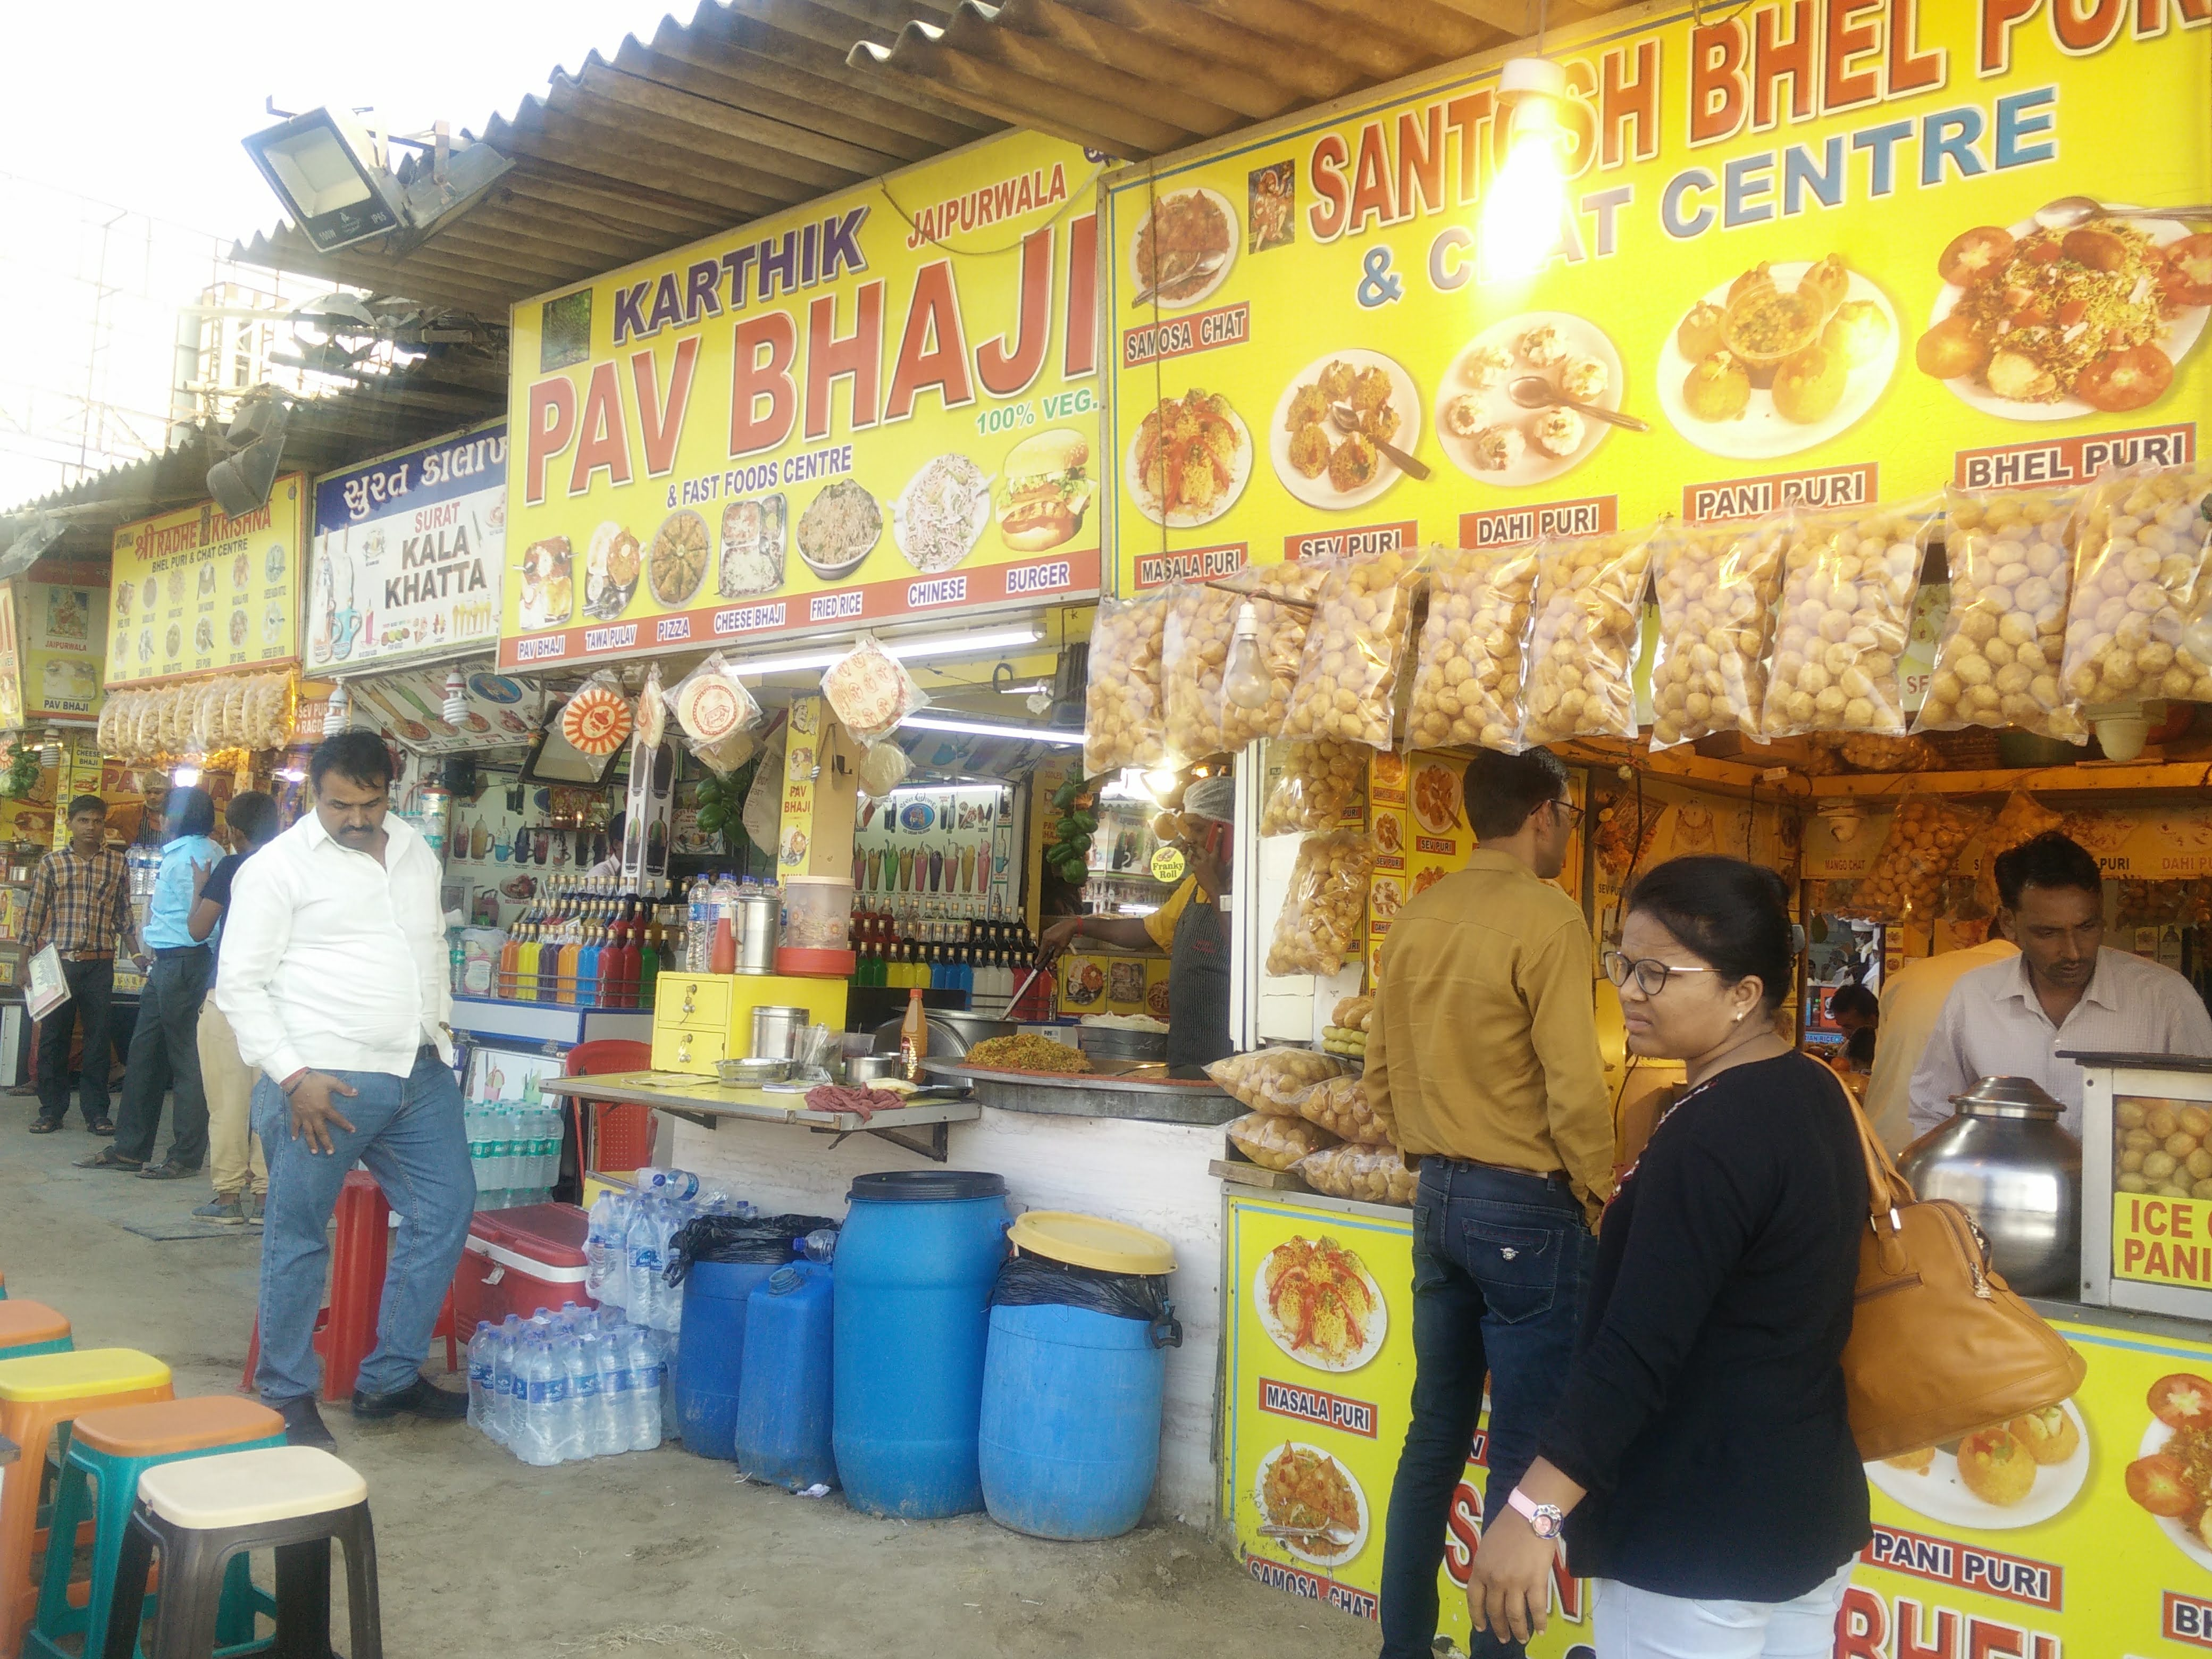
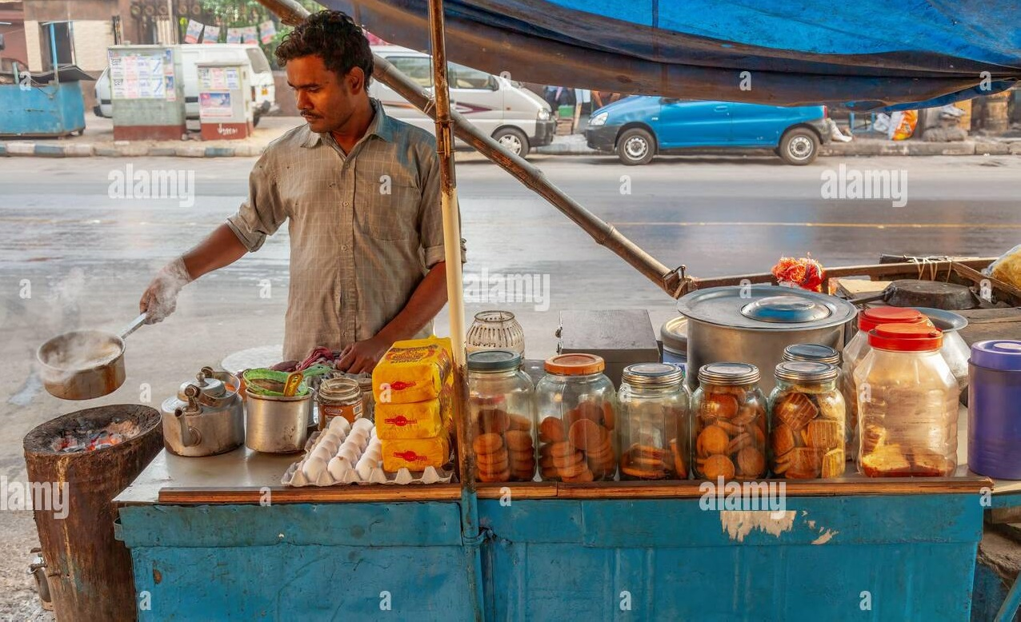
Product Sale is the Art of Any Business
Maximum Product Range
Will be 10 to 20
Not More than that…
Maximum Per Day Sale
Rs.5 to 10 Thousand
Per Month Rs. 1 Lac to 3 Lac

Slide 7
PROMOTE PRODUCTS IN PACKAGES
Heart Care Pack - Bone Care Pack
Diabetes Care Pack - Acidity Care Pack
Weight Management Pack
Skin Care Pack – Ageing Care Pack
Hair fall Care Pack
Pigmentation Care Pack
Agri Care Pack

Slide 8

Promote Products as a Brand Ambassador

Slide 9


CUSTOMER’S EXPECTATIONS
Best Quality Products
Economical Price
Easy Product Availity
Discount Offers…???
Free Gift Offers…???
After Sale Service

Slide 10
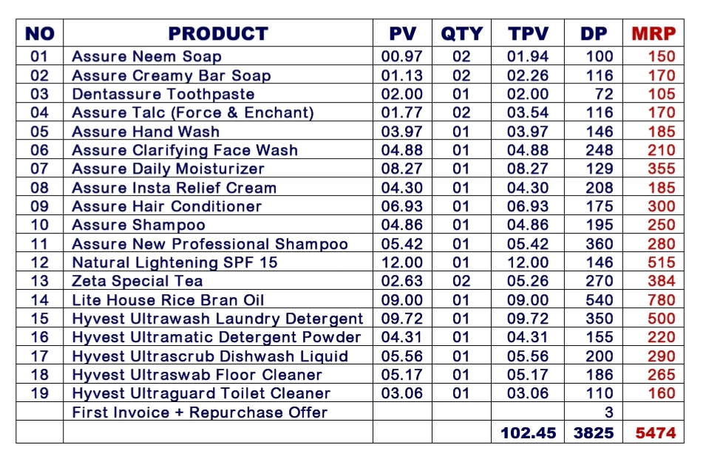
ATTRACTIVE SALE PACK
OUR OFFER
5474/- Pack
574/- Discount
4900/- Cost of Pack
540/- Spirulina Free
4360/- Net Cost
Total Benefit of
Rs.1114/-
It means Approx.
20% on MRP

Slide 11
Your 100 PPV Shopping Benefit
NO | YOU BUY PRODUCTS WORTH Rs.4,000 X 12 MONTHS | TOTAL Rs.48,000/- PER YEAR
01 | Discount on MRP is 10% to 30% Approx. Amount @ 15% | 7,200=00
02 | From 2nd to 18th Products of 10% | 4,800=00
03 | Loyal Customer Bonus Voucher Rs.2500/- X 3 = Total as per D.P.(3000) | 9,000=00
04 | Referral Cash Back Bonus Approx. | 3,000=00
05 | Total Saving on Consumption Of One Family Approx. 50% | 24,000=00

Slide 12
Your 300 Personal PV (Rs.12,000/-) per Month Benefit
SLOT | MONTHLY | 4 MONTHS | 4 MONTH BENEFITS | AMOUNT | TOTAL
2ND to 14TH | 200 PPV 8,000/- | 800 PPV 32,000/- | Retail Profit (Discount) Repurchase Offer Con. Voucher (Rs.3000 x 2) Bonus @ 16% | 4,800=00 3,200=00 6,000=00 3,000=00 | 17,000=00
15TH to 27TH | 100 PPV 4,000/- | 400 PPV 16,000/- | Retail Profit (Discount) Repurchase Offer Con. Voucher (400 PV x Rs.4/-) Bonus @ 16% | 2,400=00 1,600=00 1,600=00 1,400=00 | 7,000=00
 | 12,000=00 | 48,000=00 | TOTAL |  | 24,000=00
 | 6,000=00 | 24,000=00 | INCOME
Per Month Income Rs.6,000/-

Slide 13
Your 500 Personal PV (Rs.20,000/-) per Month Benefit
SLOT | MONTHLY | 4 MONTHS | 4 MONTH BENEFITS | AMOUNT | TOTAL
2ND to 14TH | 300 PPV 12,000/- | 1200 PPV 48,000/- | Retail Profit on (1200 PV) Repurchase Offer Con. Voucher (Rs.3200 x 3) Bonus @ 16% | 9,400=00 4,800=00 9,600=00 3,700=00 | 27,500=00
15TH to 18th 19th to 27th | 100 PPV 4,000/- 100 PPV 4,000/- | 400 PPV 16,000/- 400 PPV 16,000/- | Retail Profit on (800 PV) Repurchase Offer on (400 PV) Con. Voucher (800 PV x Rs.4/-) Bonus @ 16% | 5,200=00 1,600=00 3,200=00 2,500=00 | 12,500=00
 | 20,000=00 | 80,000=00 | TOTAL |  | 40,000=00
 | 10,000=00 | 40,000=00 | INCOME
Per Month Income Rs.10,000/-

Slide 14
Your 800 Personal PV (Rs.32,000/-) per Month Benefit
SLOT | MONTHLY | 4 MONTHS | 4 MONTH BENEFITS | AMOUNT | TOTAL
2ND to 14TH | 400 PPV 16,000/- | 1600 PPV 64,000/- | Retail Profit on (1600 PV) Repurchase Offer Con. Voucher (Rs.3200 x 4) Bonus @ 16% | 11,600=00 6,400=00 12,800=00 6,000=00 | 36,800=00
15TH to 18TH 19th to 27th | 200 PPV 8,000/- 200 PPV 8,000/- | 800 PPV 32,000/- 800 PPV 32,000/- | Retail Profit on (1600 PV) Repurchase Offer on (800 PV) Con. Voucher (1600 PV x Rs.4/-) Bonus @ 16% | 11,600=00 3,200=00 6,400=00 6,000=00 | 27,200=00
 | 32,000=00 | 1,28,000=00 | TOTAL |  | 64,000=00
 | 16,000=00 | 64,000=00 | INCOME
Per Month Income Rs.16,000/-

Slide 15
Duplication Benefit in Network Marketing
Approx. Income Chart for 500 PPV Team Network as per WT CORE & Go Getter Structure
NO | PPV | TOTAL NOS | GPV | VOLUME @ Rs.30/- | TOTAL INCOME
01 | 500 PPV | 01 | 500 | 15,000 | 2,000
03 | 500 PPV | 1+6=7 | 3,500 | 1,05,000 | 8,000
04 | 500 PPV | 6x6+1=37 | 18,500 | 5,55,000 | 40,000
05 | 500 PPV | 36x6+1= 217 | 1,08,500 | 32,55,000 | 2.5 Lac
06 | 500 PPV | 216X6+1= 1297 | 6,48,500 | 1,94,55,000 | 11 Lac

Slide 16

Work Smart & Fulfil Your All Dreams

Slide 17

ALL THE BEST…

